Slide 1







RISK MANAGEMENT & CYBER RM PROGRAM
M. S. IN CYBER RISK MANAGEMENT
B. A. IN RISK MANAGEMENT
AUGUST, 2020
Presque Isle CPCU Society

Slide 2
CYBER SECURITY ISSUES
Cyber Risk and Consequences
What Do Hackers Do With Stolen Information?
External and Insider Threats
Cyber Risk Loss Exposures
Mercyhurst University’s opportunity

Slide 3
CYBER SECURITY IS TOO IMPORTANT …
To be left to the IT department
To not be everyone’s responsibility

Slide 4
CYBER SECURITY RAMIFICATIONS
Consequences are real and significant
  You could lose your:
    Reputation
    Wages/Earning Potential
    Clients
    Job
    Company
    Freedom

Slide 5
CYBER SECURITY RAMIFICATIONS
Consequences are real and significant
  You could lose your:
    Reputation
    Wages/Earning Potential
    Clients
    Job
    Company
    Freedom

Slide 6
University of California pays over $1M to ransomware gang
Brooke Crothers posted on July 1, 2020, Fox News
Barrow County Colorado network operations disrupted after "sophisticated" cyber attack
Terrance Kelly Posted on Jul 14, 2020 CBS 46
Cyber-Attack Downs Alabama Chilton County’s Network
Sarah Coble News Writer Posted on July 9, 2020 InfoSecurity
Amazon 'thwarts largest ever DDoS (Distributed Denial of Services)
cyber-attack'
June 18, 2020 BBC News
Cyberattack hits Atlanta computers | 'Everyone who has done business' with city may be at risk March 28, 2018
Capitol One fined $80 million over 2019 hack
August 7, 2020 Wall Street Journal

Slide 7
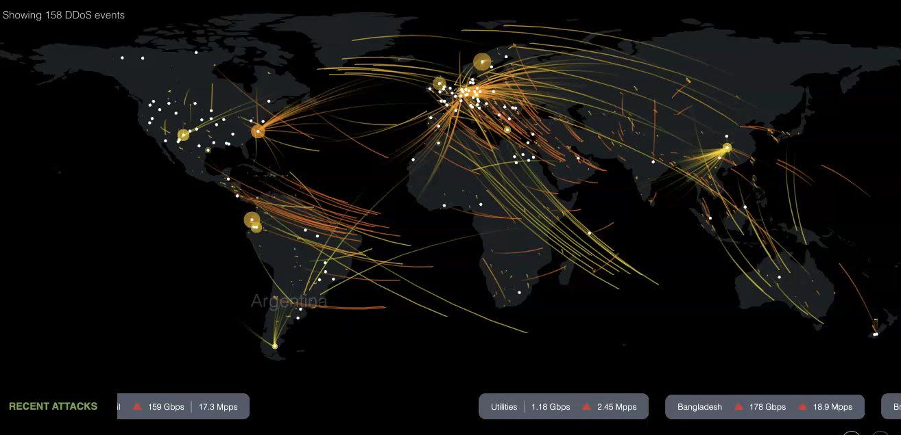

Slide 8

FOR SALE ON THE DARK WEB
Sell on the Dark Web
Personally Identifiable Information
Financial Information
Educational Information
Healthcare information
User Credentials
Information Type | Price on the Dark Web
Personal Information | $1 per line
Full Credit Reports | $25 per report
Cell Phone Accounts | $14 per account
Mature Paypal Account | $300 per account
Passports and Licenses | $10-35 per document
Bank Account Details | $200-500 per account
https://darkwebnews.com/dark-web/value-of-stolen-data-dark-web/

Slide 9
SOCIAL ENGINEERING
Act of deception - taking advantage of user’s trust
Phishing – convince victims to reveal sensitive information
Spear Phishing – targets specific individuals
Whaling – targeting a high-profile target such as CEOs (the Whale)
Vishing – phishing attempts via phone calls
Smishing – using text messages SMS to gain valuable information
Pretexting – lying to victims to gain access to sensitive information
Baiting – leave malware infected device to be found and picked up by victims
Social Engineering
Other Forms

Slide 10
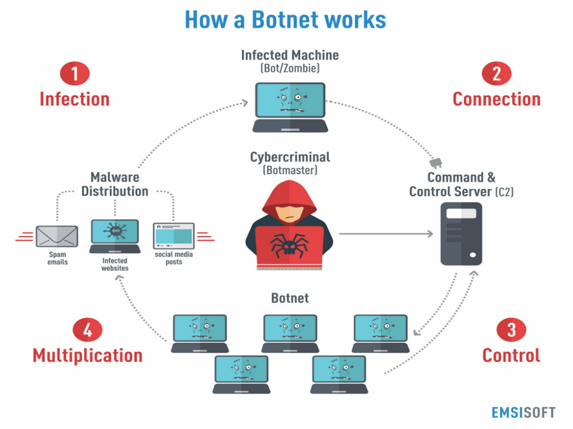
DISTRIBUTED DENIAL OF SERVICES
Botnets Spreads via:
  Social Engineering
  Phishing email
  Malware
Command and Control (C&C):
  Servers to relay instructions to each zombie device
Neustar study shows costs of $250,000 per hour
https://blog.emsisoft.com/en/27233/what-is-a-botnet/

Slide 11
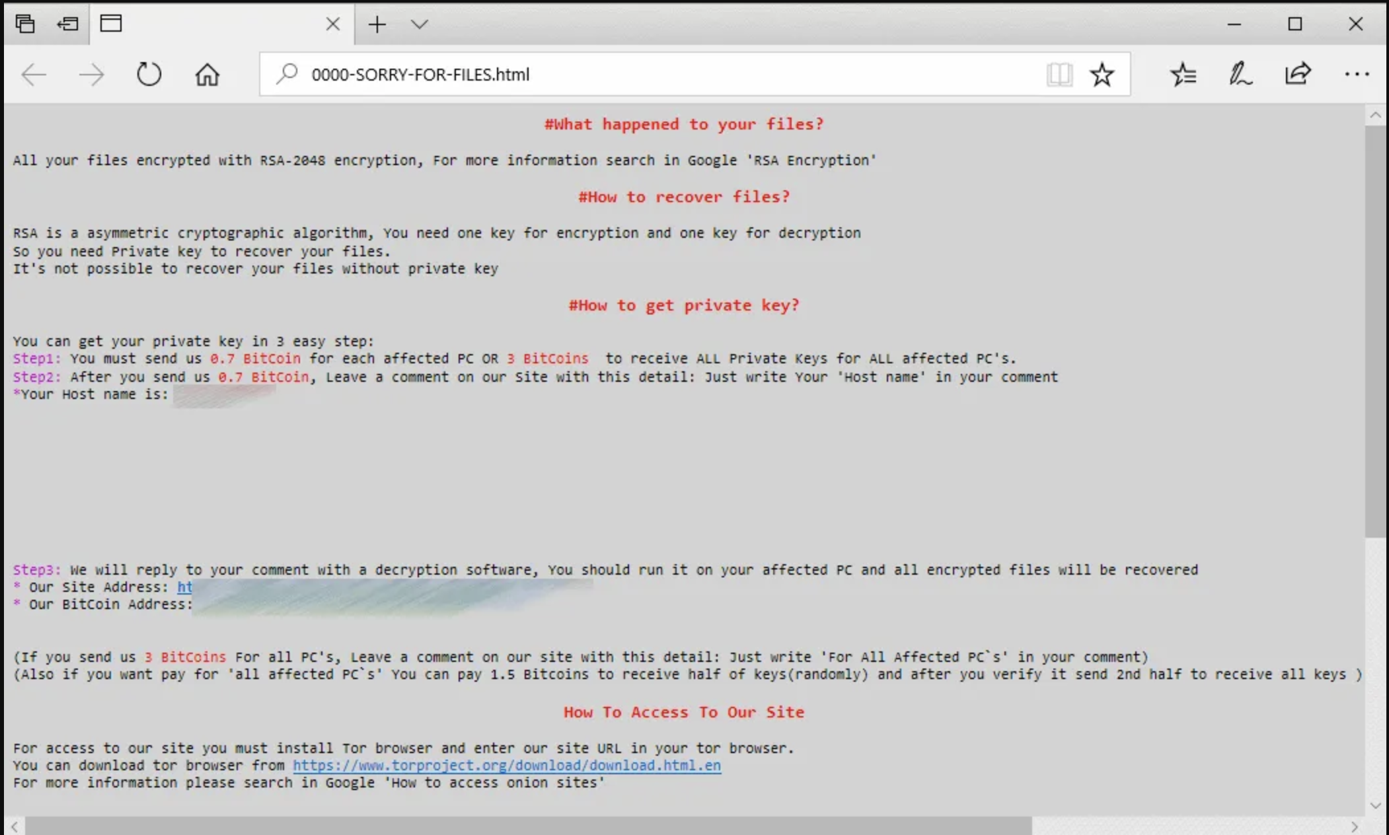
RANSOMWARE
Infected the Erie County Medical Center (NY)
Six weeks to recover
Cost $10 million
SamSam
  https://buffalonews.com//cost-ecmc-ransomware-incident-near-10-million/ and https://securityaffairs.co/wordpress/68052/malware/samsam-ransomware-campaign.html

Slide 12
RANSOMWARE
Infected 1/3 of NHS hospitals
Over 1,000 pieces of affected equipment
20,000+ procedures and appointments canceled
WannaCry
  https://www.england.nhs.uk/wp-content/uploads/2018/02/lessons-learned-review-wannacry-ransomware-cyber-attack-cio-review.pdf and https://techcrunch.com/2019/05/12/wannacry-two-years-on/

Slide 13
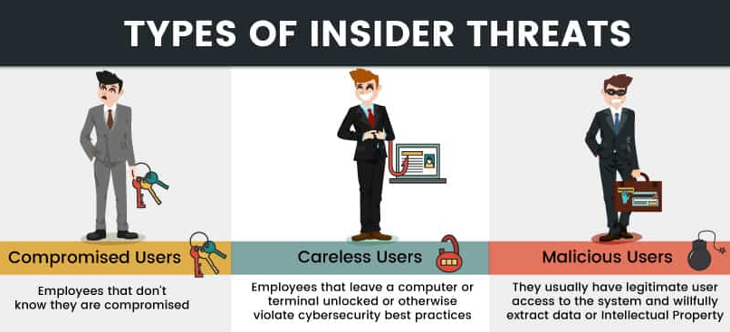
INSIDER THREATS
Attacks performed by an authorized internal individual/employee
33 % of organizations have faced an insider threat incident
Takes an average of 72 days to contain an insider threat
  https://phoenixnap.com/blog/insider-threats

Slide 14
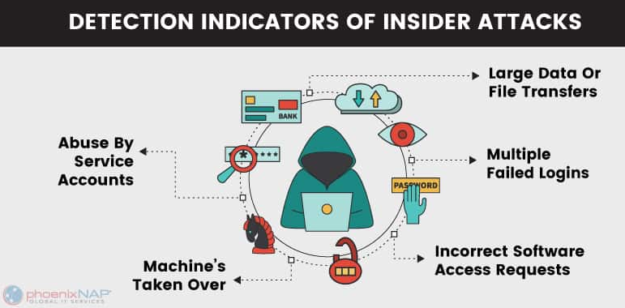
REDUCING INSIDER THREATS
Monitor the following indicators:
  Unexplained financial gain
  Multiple failed logins
  Large data or file transfers
  Odd connections to unknown IP addresses
Invest in behavior analytics, threat intelligence, anomaly detection & predictive alerts
Follow the principle of least privilege
Implement data loss prevention (DLP) technology
  https://phoenixnap.com/blog/insider-threats

Slide 15
FIRST PARTY CYBER EXPOSURES
Damaged hardware, software, and computer networks
Compromised or stolen data and cyber extortion
Business interruption and extra expense
Post-breach expenses
Reputational damage

Slide 16
THIRD PARTY CYBER EXPOSURES
Customer liability v trading partner liability
Liability for customer data
  Invasion of privacy and breach of contract
  Class action lawsuits
Network security liability
  Damage to third-party’s network
  E-media liability for libel, slander, trademark infringement, copyright
Directors and Officers (D&O) exposures

Slide 17
FINANCIAL CONSEQUENCES
Physical media
Data assets
Intellectual property
Forensic expert costs
Litigation costs and verdicts
  Customer suits
  Derivative suits
Regulatory fines
Reputational costs
Firm devaluation

Slide 18
INSURANCE FOR CYBER LOSSES
Data compromise response expenses
Computer attack and cyber extortion
Data compromise liability
Network security liability
Electronic media liability
Identity recovery

Slide 19
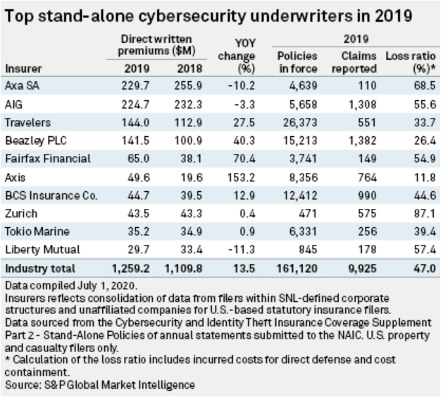
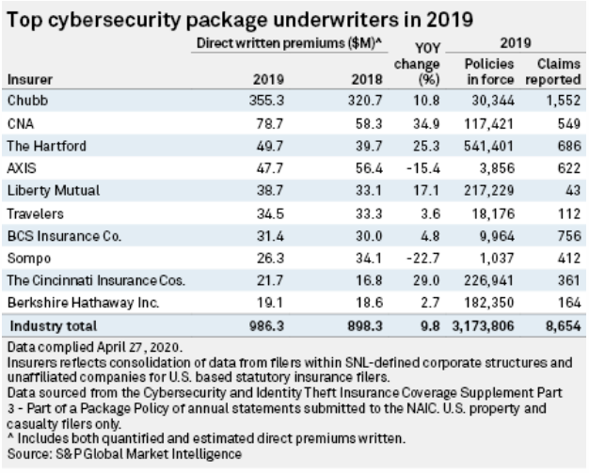
CYBER INSURANCE MARKET

Slide 20
GROWING DEMAND FOR UNIVERSITY EDUCATION IN RISK MANAGEMENT AND CYBER SECURITY
14.7%
National unemployment rate April 2020
3.9%
Insurance industry unemployment rate April 2020
400,000
  # of job openings in the insurance industry in the next 2 years
25%
  Potential retirements in insurance this year
30%
  Retirements expected to be more in insurance than any other industry
Banking Finance Insurance
  Largest industry employing cyber professionals
37%
  Jobs growth in cyber security

Slide 21
PROGRAMS FROM THE F.W. HIRT-ERIE INSURANCE RISK MANAGEMENT DEPARTMENT
Master of Science Cyber Risk Management
Bachelor of Arts Risk Management

Slide 22
CHARACTERISTICS OF SUCCESSFUL RISK MANAGEMENT PROGRAMS
Programs:
Industry interaction:
  On campus speakers
  Student involvement in industry events
  Internships and job shadowing
Start on designations
  Competitive advantage for students
Industry-ready grads:
Deep understanding of the industry
Computing skills (data science, cyber security)
Soft skills training
  Resume writing and review
  Presentation, writing and interviewing
Professional social media profiles

Slide 23
GAMMA KAPPA CHAPTER – GAMMA IOTA SIGMA
“Risk Management and Insurance Club”
Industry veteran interactions
Leadership opportunities
Representatives from the following companies have come to campus:
Cincinnati Financial
Erie Insurance
Westfield Insurance
Insurance organizations:
PI CPCU Society
Insurance Professionals of NWPA

Slide 24
RISK MANAGEMENT FACULTY
Walker College of Business
  Gary Sullivan, MBA, CPCU, AIC, AIM, AIS
    23 years insurance experience
      8 = Auto-Owners Mutual Insurance
      15 = Erie Insurance
    Advisory Board: West Hill Global
    Insurance Advisory Board: Amenity Analytics
    Strategic Advisor: EOS Venture Partners
    Speaker at PLRB, Connected Claims, Insurance Networking News (2018)

Slide 25
M.S. IN CYBER RISK MANAGEMENT
Online classes started in Fall 2018
Courses offered in 8-week mini-semesters
Students take one class per mini-semester
Courses taught by full time faculty members
Mercyhurst juniors can enroll in 4+1 programs
Ridge College of Intelligence Studies and Applied Sciences offers cyber security courses
Walker College of Business offers risk management courses

Slide 26

M.S. IN CYBER RISK MANAGEMENT: COURSES
CIS Courses
Risk Management Courses
CIS 500 Computing and Information Science Concepts
CIS 501 Probability and Statistics
CIS 560 Cyber Networks
CIS 561 Cyber Security
CIS 564 Cyber Warfare
CIS 565 Cyber Law & Policy
CIS 598 Research Methods
CIS 599 Research Project
RMGT 520 Cyber Risk Management
RMGT 530 Advanced Property & Liability Insurance*
RMGT 540 Advanced Finance & Accounting for Insurance Professionals*
RMGT 550 Enterprise Risk Management
*The Institutes’ Collegiate Studies for CPCU Certificate

Slide 27
B. A. IN RISK MANAGEMENT
Classes now offered
Courses being taught by full time faculty
Ridge College offers cyber security courses
Walker College offers risk management courses

Slide 28
BA IN RISK MANAGEMENT: COURSES
CIS Courses
Risk Management Courses
CIS 100 Introduction to Computer Science
CIS 160 Introduction to Cyber Security
CIS 365 Cyber Security Law & Policy
CIS 400 Ethics in Computing
RMGT 120 Fundamentals of Risk Management
RMGT 320 Risk Management and Insurance
RMGT 325 Finance and Accounting for Insurance Professionals*
RMGT 330 Property and Liability Insurance or
RMGT 420 Insurance Operations and Regulations*
*The Institutes’ Collegiate Studies for CPCU Certificate

Slide 29
BENEFITS TO EMPLOYEES AND COMPANY
Personal and professional development
Preparation for the next growth market in the P&C industry
Project assignments for risk management assessments, data analysis, consultancy
No initial out-of-pocket expenditures to Erie Insurance Employees who participate in the Tuition Reimbursement program
Tuition discounted for Erie insurance Employees

Slide 30
THANK YOU
Visionary program
Tremendous support
Fills the needs of industry

